Slide 1

Smart home IoT Temp monitor
Ian Hutchinson

Slide 2
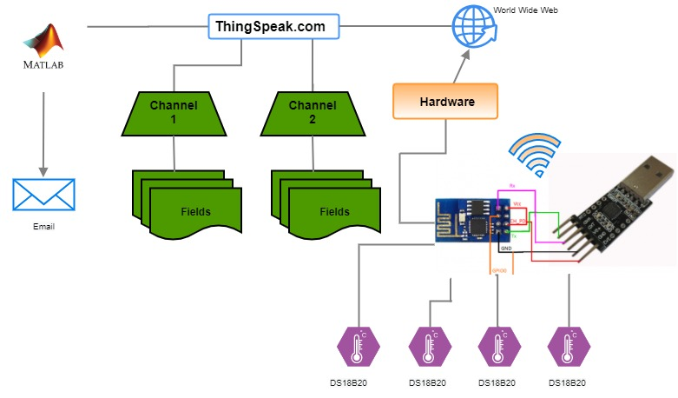
Overview
Domain:
Environmental Monitoring
Scope:
Program and deploy remote Wi-Fi temperature sensing devices.
Retrieve and store data on an IoT platform.
Access data remotely from a device with an internet connection.

Slide 3
Software
Arduino IDE
Aurduino IDE is special software that allows you to write sketches.
The Arduino language is based on a hardware programming language called processing, similar to C language.
Used to upload code to ESP8266 modules.
MatLab
Is integrated with ThingSpeak platform.
Novice friendly - Visualise data using pre-built plots and flexibility offered to customise the visualisation
- Built-in support for prototyping, testing and running models on our environmental data.

Slide 4
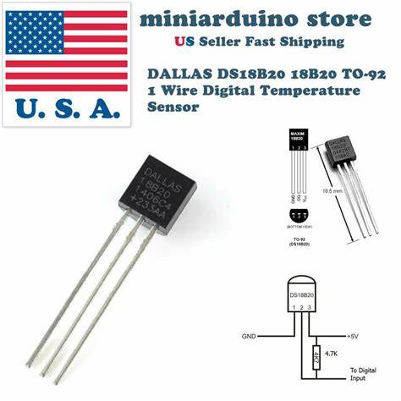
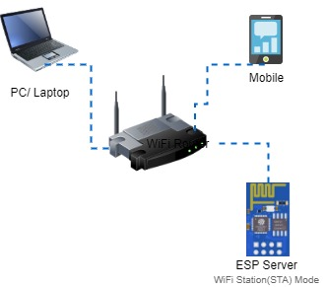
Devices
DS18B20 Temp Sensor
Very common and widely available temperature sensor.
Relatively high accuracy (±0.5°C) over a large temperature range.
Operating voltage is 3.0 – 5.5v.
Communicates using the Dallas Semiconductor 1-wire Protocol.
Has a unique 64-bit serial code, allows multiple sensors to function on the same 1-wire bus.
ESP8266 (Web Client)
Low cost microcontroller
Main interest is its Wi-Fi connection, which allows it to publish data (temp. in this case) to ThingSpeak online dashboard.
The ESP8266WiFi library is a complete adaptation (a port) of the Wi-Fi library for Arduino made by Espressif.
Programmed using Arduino IDE
Connects directly to the internet and doesn’t require a gateway.
A web client interacts with a web server via an application programming interface (API).
Sending sensor data using TCP/ IP (802.11) to ThingSpeak
Source: 5pcs DALLAS DS18B20 18B20 TO-92 1 Wire Digital Temperature Sensor | eBay

Slide 5

Transmission Media
Transmission media is a communication channel that carries the information from the sender to the receiver.
Unguided media offers flexibility in terms of sensor location. No physical wiring.
Wireless transmission and reception of data is carried out using an antenna.
The ESP8266 transmits radio waves in all directions of free space.
The ESP8266 operates within a frequency range of 2400-248MHz

Slide 6
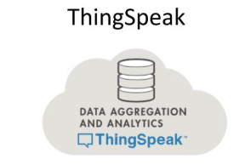
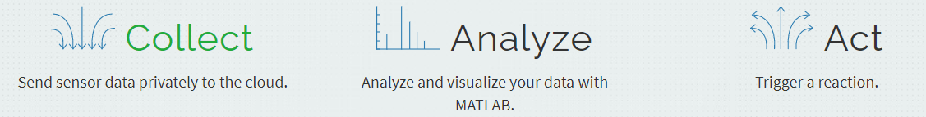
Application Layer
Communication between client and server using HTTP Protocol
ESP module submits an HHTP request to the ThingSpeak channel using the GET method.
The server listening for a request will respond to an HTTP request with one or more response messages
An API key allows you to access the web server privately
The API key information is included in the Arduino IDE program and stored in the ESP8266 memory.
Display the temp sensor data through gauges and charts.
Source: IoT Analytics - ThingSpeak Internet of Things

Slide 7
Project Status
Code developed that displays temperature to Arduino terminal
Next Steps:
Continue on progress made and get data transmission to Thingspeak cloud.
Get started with Matlab.
Look into integrating weather API into project.

